Slide 1
Concussion at AFC

Slide 2
Monica Thorne
Senior Physiotherapist
Senior Men’s Head Physiotherapist at AFC

Slide 3
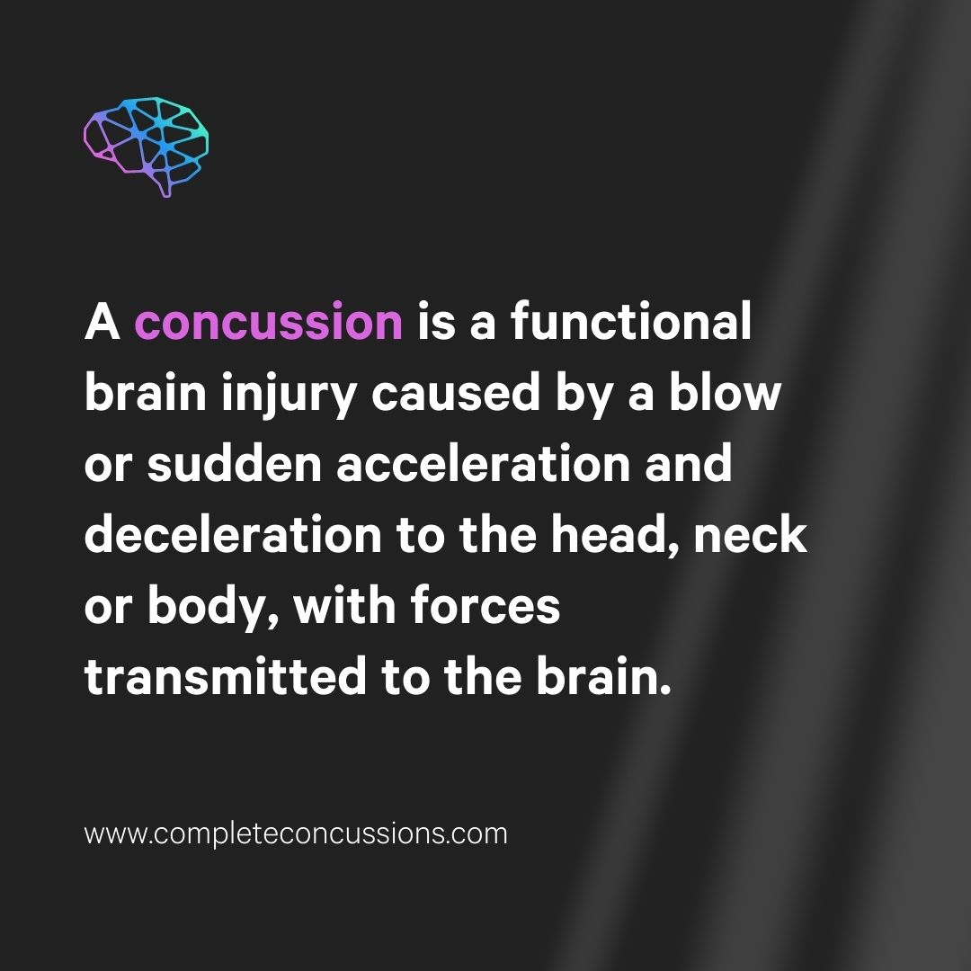
What is concussion?
It is a form of traumatic brain injury!
Impact causes a biochemical imbalance within the brain
Reduced blood flow and energy deficits affecting brain function
It may or may not be associated with a loss of consciousness
Symptoms can be immediate or delayed
Imaging such as CT or MRI not likely to show injury
They can happen anywhere, not just at games
AFL has the 2nd highest rate of concussion worldwide
Girls are 1.5 – 2 x more likely to sustain a concussion playing the same sport

Slide 4
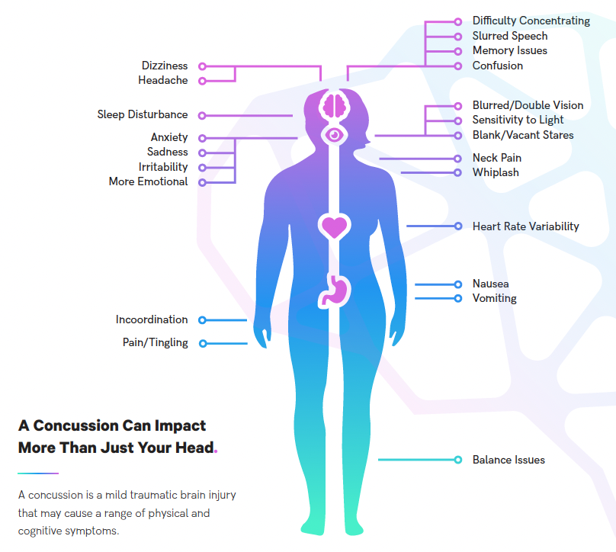
Identifying Concussion
Mechanism and Visual Signs
Collision with another player, object or the ground
Slow to get up/unconscious
Dazed/disorientated
Missing kicks, odd behaviour, etc…
Irritable/arguing with team mates
Self removal from play
Be aware of concussion with other injuries
www.completeconcussions.com

Slide 5
https://www.youtube.com/watch?v=_x91sZCnDzw

Slide 6
What to do if a concussion is suspected

Slide 7
Sideline management
Red Flags – send to ED
What to do
Repeating questions
Severe or worsening headache
Seizure or convulsion
Vomiting
Decreasing level of consciousness
Bruising around eyes or ears
Weakness/numbness in arms or legs
Increased confusion
Difficulty recognizing people or places
Slurring of speech
IF IN DOUBT, SIT THEM OUT!
If a concussion is suspected the player should NOT return to play
Trust your gut instinct
Send straight to ED if there are red flags or if you hold concern
Fill out an incident report and provide with the concussion info sheet
Refer them to a health care professional who is trained in concussion
Don’t let them drive
Give instruction to the person they are going home with

Slide 8
Sideline Management

Slide 9
But what if they seem fine?
Concussion can be a silent injury
Even if symptoms are mild there has still been an injury to the brain that needs time to recover
Don’t take the player’s word for it – their cognition may be affected
Once concussed, you are more likely to sustain further concussions with increased severity
Severe injuries take longer to recover
Immediate removal from play has been associated with shorter recovery time and less severe symptoms

Slide 10
The First 24-48hrs
At home
What next?
Don’t let them sleep for the first 3hrs following injury
Watch out for red flags developing or symptoms worsening
Do not consume alcohol
Limit screen time
Avoid physical activity
Light aerobic activity such as walking is ok
Player is allowed to sleep at night but they need to be checked regularly
You don’t need to wake them to check on them
Make an appointment with a trained healthcare professional
Assessment needs to be done within the first 24-48hrs of injury
SportsCare physiotherapists are specifically trained in concussion assessment and management
Therapists available at Dickson and Weston Clinics

Slide 11
A Word of Warning
Not all health care providers are trained in the management of concussion
ED is trained in managing and ruling out serious injury, not long term management
Not all GP’s are trained in concussion management and how to assess it appropriately

Slide 12
Starting rehab and the return to play process

Slide 13
Concussion Policy
AFL and Club Policy
https://www.play.afl/clubhelp/policies/concussion-management/
Minimum 12 days rest from play
Day injury was sustained is day 0
Can return to play on the 12th day provided has successfully completed loading program
Require signed clearance from a medical doctor
Dependent on symptoms and progression through loading program
More conservative with kids
www.completeconcussions.com

Slide 14
Rehab Process
Once you have sustained a concussion a full recovery is completely achievable without any long term impacts
Initial with physiotherapist
CCMI concussion testing (SCAT 5)
Musculoskeletal assessment for associated injuries
Advice and education about managing symptoms
Clear guidelines about returning to school/work and physical activity
Specific concussion rehab exercises that are critical to recovery
Follow-up as required
Graded return to sport
Must follow loading program
Clear instructions for training and for coaches
Advice will be dependent on symptoms and other injuries

Slide 15
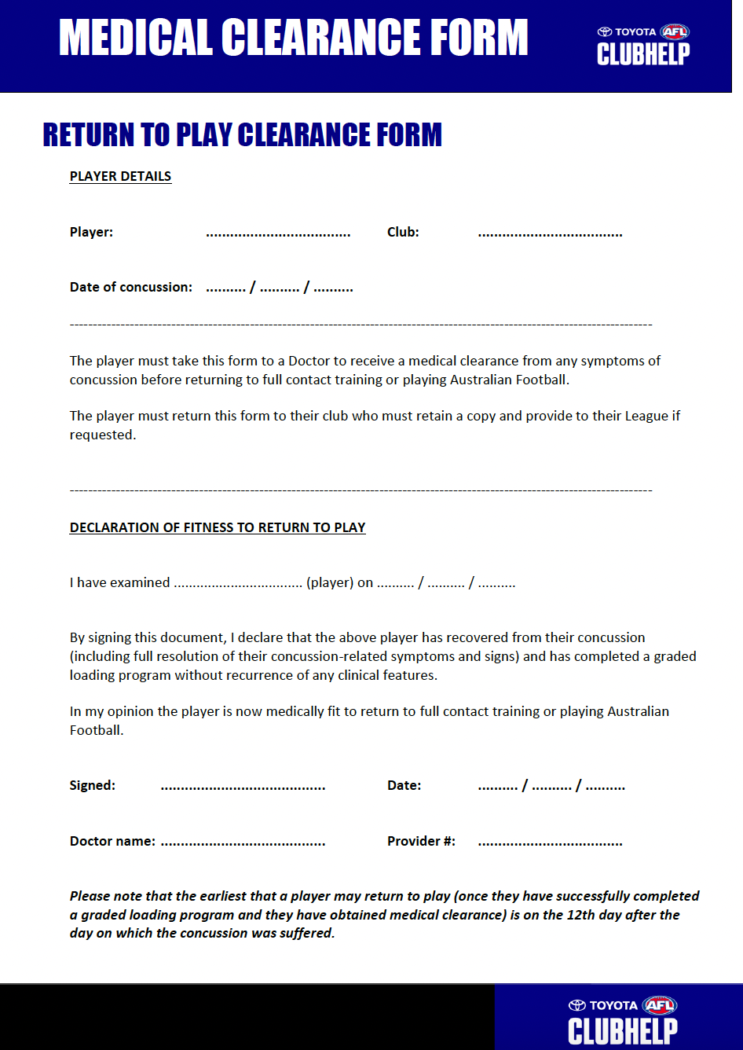
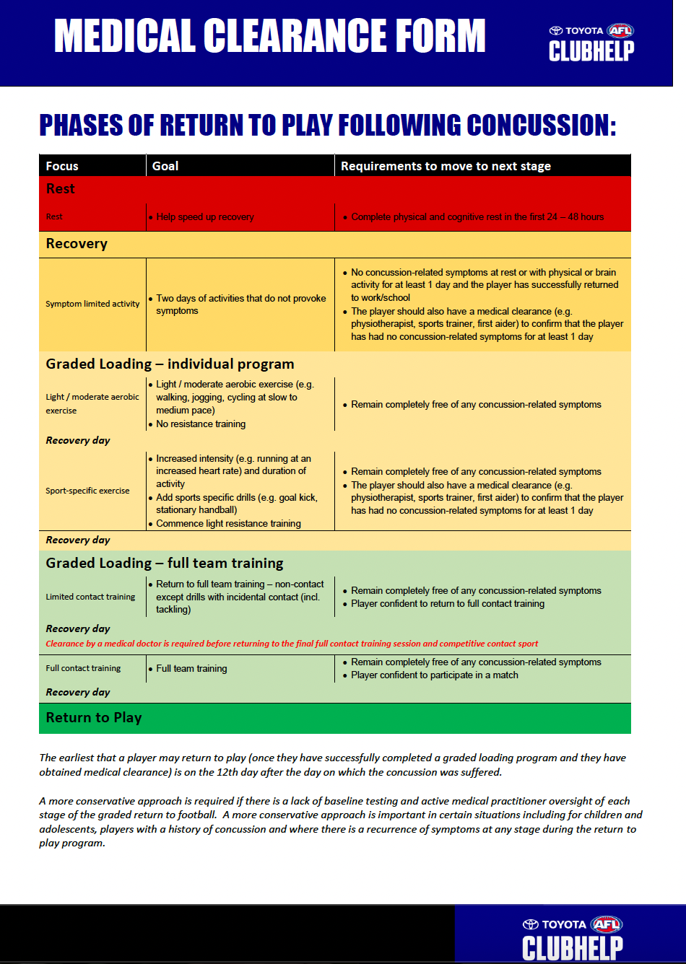
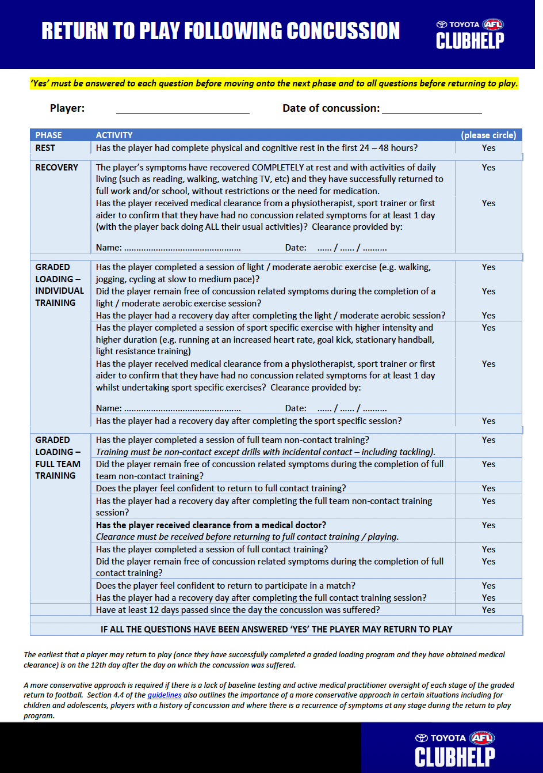
Clearance
Once rehab is complete your physio will refer you to medical doctor for final clearance to return to sport
They will send your pre and post injury data or a letter stating you have completed rehab and the loading program

Slide 16
Managing Concussion
Baseline Testing
Head Gear and Mouth Guards
Must be done every 12 months
Requirement for senior squads
Can also be done for junior players
Can’t stop concussion but can improve chances of returning to play safely
Helps to reduce risk of concussion severity
Can help guide assessment and treatment
CCMI Player App – tracks current concussion but also stores details of previous concussions
Head gear has no proven effect in preventing concussion but can protect from other impact injuries
There is some evidence that mouth guards could help in preventing concussion
Mouth guards must be fitted by a dentist

Slide 17
Questions?

Slide 18
Thank you.
Contact Us
Dickson Locations
2/55 Woolley St Dickson ACT 2602 Ph: 6248 0473
Dickson Park Professional Centre, Cnr Antill St and Cowper St Dickson ACT 2602 Ph: 6248 9841
*Club Discount available for all Ainslie Players

